Slide 1
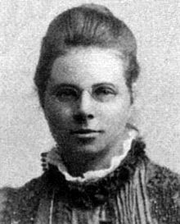
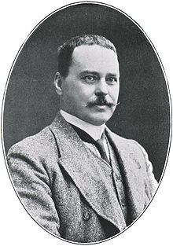
Modelling Infectious Diseases
Based upon the work of Hudson and Ross, the Kermack-McKendrick (1933) S-I-R equations model the spread of infectious diseases throughout a population
$$\frac{ⅆS}{ⅆt}=−βSI$$
$$\frac{ⅆI}{ⅆt}=βSI−δI$$
$$\frac{ⅆR}{ⅆt}=δI$$
$S(t)$ = Susceptible population
$I(t)$ = Infected population
$R(t)$ = Recovered population
Hilda Hudson
$β=$ Infection rate factor
$δ=$ Recovery rate factor
As time progresses, the population changes from one compartment to the next: $S→I→R$
Note: the total population in this model does not change
Ronald Ross
We seek the functions $S\left(t\right), I\left(t\right),and R(t)$

Slide 2
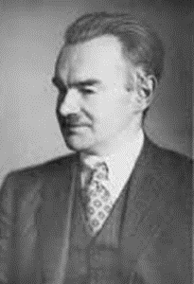
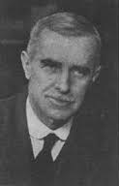
Modelling Infectious Diseases
$β=$ Infection rate factor
$δ=$ Recovery rate factor
As people become infected, the susceptible population decreases
As more people are infected, the faster the disease is spread to the susceptible
$$\frac{ⅆS}{ⅆt}=−βSI$$
William Kermack
Having more susceptible people makes it easier for the infection to find a new host
Susceptible people become infected (𝜷) and infected people become recovered ($δ$)
$$\frac{ⅆI}{ⅆt}=βSI−δI$$
The number of recovered people increases over time
$$\frac{ⅆR}{ⅆt}=δI$$
Anderson McKendrick

Slide 3
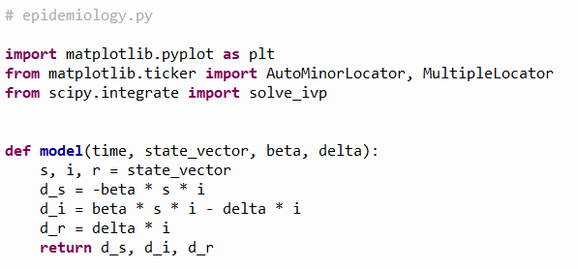



Open epidemiology.py
①
②
③
④
$β=$ Infection rate factor
$δ=$ Recovery rate factor
$$\frac{ⅆS}{ⅆt}=−βSI$$
$$\frac{ⅆI}{ⅆt}=βSI−δI$$
$$\frac{ⅆR}{ⅆt}=δI$$

Slide 4
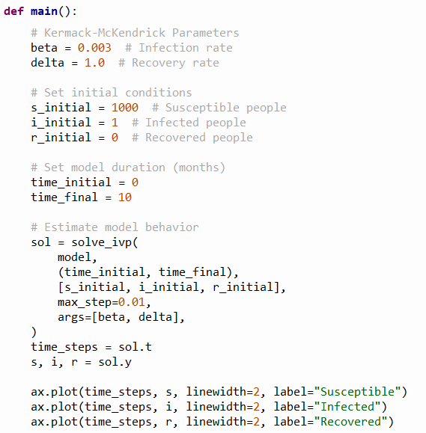
View epidemiology.py
①
②
③
④
⑤
⑥
⑦
⑧
⑨
⑩

Slide 5
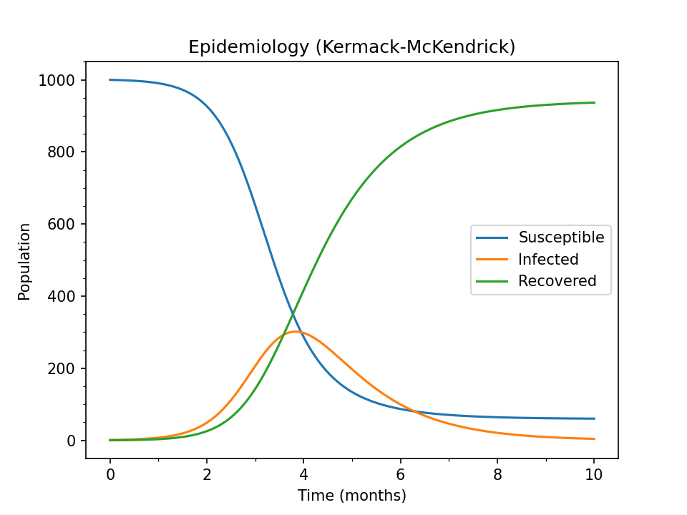
SIR Model Epidemiology
The infected population will decrease more slowly than it rises, hence it takes much longer to rid a population of an infection than it takes for the initial infection to spread
A percentage of people will remain susceptible for a very long time - hence the need for an ongoing vaccination program – think about smallpox, polio, etc.

